Slide 1
Tuesday, November, 13th, 2012
http://www.youtube.com/watch?v=m0YLDqmslA4&feature=related

Slide 2
Reading Across the Curriculum-Objectives Teachers will be able to:
Explain the two new reading strategies for the quarter (Vocabulary Strategies and Paragraph Shrinking)
Use the paragraph shrinking strategy with an elbow partner effectively
Describe at least one vocabulary strategy they can use with their content vocabulary

Slide 3
Strategy 1- Vocabulary Strategies “The Matthew Effect” [Matthew 13:12] Students with low word recognition and fluency skills will read less. “The rich get richer. The poor get poorer.” (Stanovich, 1986)
http://comprehensiveliteracy.weebly.com/vocabulary.html
Mneumonic devices, Frayer model,concept sorts, word hunts http://www.adlit.org/strategy_library/
Anita Archer- explicit vocabulary!! Includes prefix and suffix identification
Graphic Organizers-lots of examples
Vocabulary Games- fly swatter game
http://www.readingrockets.org/article/40304/

Slide 4
Smarter Balance Vocabulary

Slide 5
Vocabulary Squares-Jim Burke

Slide 6
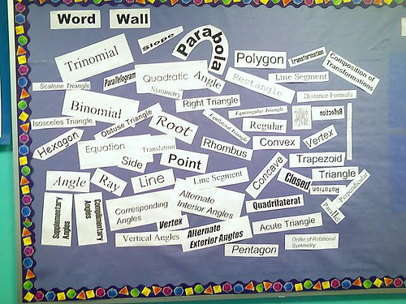
Vocabulary-Secondary Math Word Wall

Slide 7
PALS-Peer-assisted Learning Strategy
Both of these strategies can and should be implemented as peer assisted learning strategies.
Students should be able to discuss their learning in order to solidify each new concept or words!

Slide 8
PALS-Peer-assisted Learning Strategy
Vocabulary strategy
Paragraph Shrinking- check out the directions in your NCA binder.
Student card samples and directions cards for the teachers

Slide 9
Quarter Two- Data collection
SRI from September, another test coming in December
What questions do you have???

