Slide 1
Welcome to your first day with Ms. Ashburn
Friday, September 9th, 2016

Slide 2
Welcome Students!
Fluffy Agenda
Get to know you activity
9/11 Remembrance
Writing prompt
Parent Homework??
Learning Style inventory

Slide 3
Welcome Students!
Fluffy Agenda
Meet Ms. Ashburn
Get to know you activity
Fun stuff happening
LINK Schedule
Growth Mindset

Slide 4
Can you read this?

Slide 5
Can you read this?

Slide 6
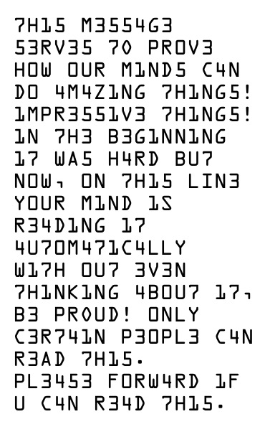
Can you read this?

Slide 7
Curriculum Goals- Decoding Classes
We will have I can statements for every five-ten lessons
We will have personal goals for our reading education, including increasing our lexile level, grade level, comprehension, strategy awareness, fluency…
We will maintain a positive, growth mindset!!
Learn more tomorrow!

Slide 8
Reading Support Syllabus- Comprehension Fluffy Agenda
Expectations
Icebreaker
Growth Mindset Survey
Strategy List

Slide 9
Advisory Class- What is it?
Home base
Learn a little about your classmates
Activity with your LINK Leaders

Slide 10
Ashburn’s beliefs about learning
I believe in your potential and am committed to helping everyone get smarter.
It is important for me to take on challenges, exert effort, give my best!!
Working hard to learn new things makes you smarter—
-it makes your brain grow new connections.
School is not a place that judges you.
It is a place where people help your brain grow new connections.
Adapted from Carol Dweck Mindsets

Slide 11
Expectations
What does classroom behavior look like in high school?
What rules are important to you?
What behaviors/class procedures are important to you?

Slide 12
Rules for a successful high school career
Be respectful.
Be responsible.
Follow directions.
Be punctual.
Be organized.
Be a self-starter.
Be prepared.
Ashburn’s House Rules
1) Talk nice, say nice things
2) Clean up messes
3) Learn something new everyday

Slide 13
7th hour
Finish ten questions
Rules for school and class
Videos
Writing prompt
What excuses have been made for you?
What do you expect from society?

